Slide 1
https://github.com/dchimeno/introduction_ml

Slide 2


Experto en Big Data Machine Learning with Python Daniel Chimeno Big Data Developer
Universidad Pontificia de Salamanca 2020 - 2021

Slide 3

What is Machine Learning (ML)?
APPLIED MACHINE LEARNING IN PYTHON
The study of computer programs (algorithms) that can learn by example
ML algorithms can generalize from existing examples of a task
– e.g. after seeing a training set of labeled images, an image classifier can figure out how to apply labels accurately to new, previously unseen images
Notes:
Machine Learning es una disciplina científica del ámbito de la Inteligencia Artificial que crea sistemas que aprenden automáticamente. Aprender en este contexto quiere decir identificar patrones complejos en millones de datos. La máquina que realmente aprende es un algoritmo que revisa los datos y es capaz de predecir comportamientos futuros. Automáticamente, también en este contexto, implica que estos sistemas se mejoran de forma autónoma con el tiempo, sin intervención humana

Slide 4




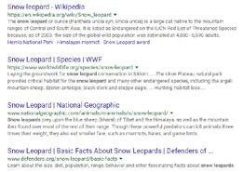





Machine Learning models learn from experience
OK
Labeled examples (Email spam detection)
Spam
User feedback
(Clicks on a search page)
Surrounding environment (self-driving cars)

Slide 5
Machine Learning brings together statistics, computer science, and more..
APPLIED MACHINE LEARNING IN PYTHON
Statistical methods
Infer conclusions from data
Estimate reliability of predictions
Computer science
Large-scale computing architectures
Algorithms for capturing, manipulating, indexing, combining, retrieving and performing predictions on data
Software pipelines that manage the complexity of multiple subtasks
Economics, biology, psychology
How can an individual or system efficiently improve their performance in a given environment?
What is learning and how can it be optimized?

Slide 6
Applied Machine Learning

Slide 7
Key types of Machine Learning problems
APPLIED MACHINE LEARNING IN PYTHON
Supervised machine learning: Learn to predict target values from labelled data.
Classification (target values are discrete classes)
Regression (target values are continuous values)

Slide 8
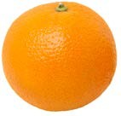








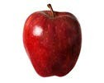

Supervised Learning (classification example)
APPLIED MACHINE LEARNING IN PYTHON
Training set
Y
Future sample
Sample | Target Value (Label)
𝑥𝑥₁ | Apple 𝑦𝑦1
𝑥𝑥₂ | Lemon 𝑦𝑦₂
𝑥𝑥₃ | Apple 𝑦𝑦3
𝑥𝑥₄ | Orange 𝑦𝑦₄
X
Classifier
f : X → Y
f
f
At training time, the
Label: Orange
After training, at prediction time, the trained model is used to predict the fruit type for new instances using the learned rules.
classifier uses labelled examples to learn rules for recognizing each fruit type.

Slide 9
Key types of Machine Learning problems
APPLIED MACHINE LEARNING IN PYTHON
Supervised machine learning: Learn to predict target values from labelled data.
Classification (target values are discrete classes)
Regression (target values are continuous values) Unsupervised machine learning: Find structure in unlabeled data
Find groups of similar instances in the data (clustering)
Finding unusual patterns (outlier detection)

Slide 10

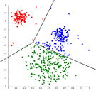




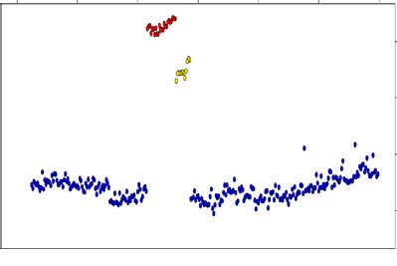

Unsupervised learning: finding useful structure or knowledge in data when no labels are available
APPLIED MACHINE LEARNING IN PYTHON
Finding clusters of similar users (clustering)
Detecting abnormal server access patterns (unsupervised outlier detection)
Careful researchers
Time on site
Power users
Quick browsers
Pages accessed
Server accesses
Time

Slide 11
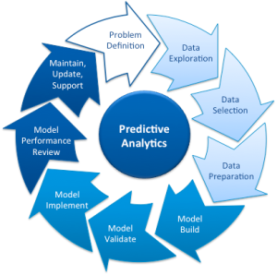
Machine Learning methodology
Choose:
How to search for the settings/parameters that give the best model
for this evaluation criterion
Choose:
A feature representation
Type of model to use
Choose:
What criterion distinguishes good vs. bad models?

Slide 12










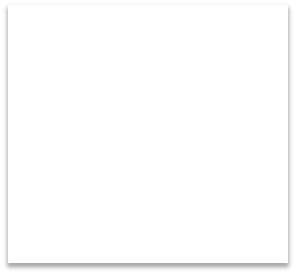





Represent / Train / Evaluate / Refine Cycle
APPLIED MACHINE LEARNING IN PYTHON
Representation: Extract and select object features
Train models: Fit the estimator to the data
Feature and model refinement
Evaluation

Slide 13














Representing a piece of fruit as an array of features
APPLIED MACHINE LEARNING IN PYTHON
width
1. Feature representation
Label information
(available in training data only) Feature representation
height
2. Learning model
Classifier
mass
color
Predicted class (apple)

Slide 14
Python Tools for Machine Learning

Slide 15



scikit-learn: Python Machine Learning Library
APPLIED MACHINE LEARNING IN PYTHON
scikit-learn Homepage
http://scikit-learn.org/
scikit-learn User Guide
http://scikit-learn.org/stable/user_guide.html
scikit-learn API reference
http://scikit-learn.org/stable/modules/classes.html
In Python, we typically import classes and functions we need like this:
from sklearn.model_selection import train_test_split from sklearn.tree import DecisionTreeClassifier

Slide 16


SciPy Library: Scientific Computing Tools
APPLIED MACHINE LEARNING IN PYTHON
http://www.scipy.org/
Provides a variety of useful scientific computing tools, including statistical distributions, optimization of functions, linear algebra, and a variety of specialized mathematical functions.
With scikit-learn, it provides support for sparse matrices, a way to store large tables that consist mostly of zeros.
Example import: import scipy as sp

Slide 17
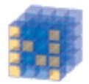
NumPy: Scientific Computing Library
APPLIED MACHINE LEARNING IN PYTHON
http://www.numpy.org/
Provides fundamental data structures used by scikit-learn, particularly multi-dimensional arrays.
Typically, data that is input to scikit-learn will be in the form of a NumPy array.
Example import: import numpy as np

Slide 18

Pandas: Data Manipulation and Analisys
APPLIED MACHINE LEARNING IN PYTHON
Provides key data structures like DataFrame
Also, support for reading/writing data in different formats
Example import: import pandas as pd

Slide 19

matplotlib and other plotting libraries
APPLIED MACHINE LEARNING IN PYTHON
http://matplotlib.org/
We typically use matplotlib's pyplot module:
import matplotlib.pyplot as plt
We also sometimes use the seaborn visualization library (http://seaborn.pydata.org/)
import seaborn as sn
And sometimes the graphviz plotting library:
import graphviz

Slide 20
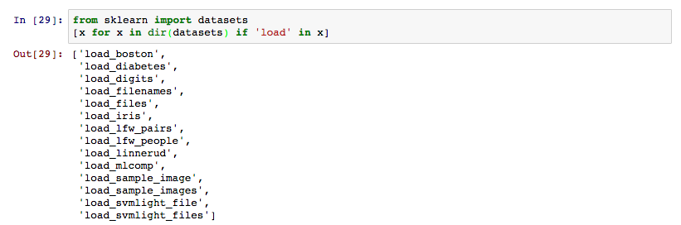
Scikit-learn: Datasets
Para favorecer el aprendizaje, sklearn viene con varios datasets de muestra con los que podemos jugar:

Slide 21
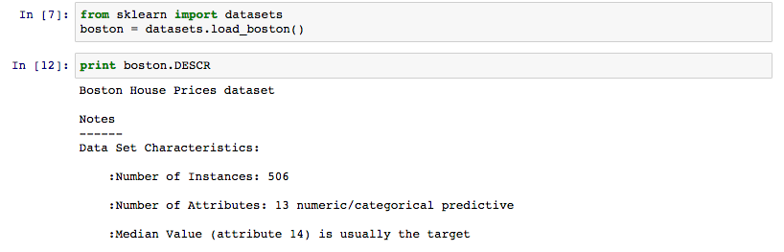
Scikit-learn: Datasets
Podemos cargar cualquiera de ellos con load_{dataset}(), y obtendremos un diccionario con distintas entradas, una de ellas DESCR que contiene la descripción del mismo.
Además los datos suelen venir como “data” y la variable objetivo a predecir en ese dataset como “target”

Slide 22
Scikit-learn: Datasets
Ejercicio:
Carga el dataset de Boston de los precios de las casas
Por defecto, una vez cargado, tendremos .data como un ndarray, conviértelo en un pandas dataframe y asigna los nombres correctos a las columnas (.DESCR, .feature_names)
Crea una nueva columna que sea con el precio de la vivienda (.target)
Calcula los descriptivos de las variables, en particular calcula los cuartiles del precio de las viviendas

Slide 24
An Example Machine Learning Problem

Slide 25

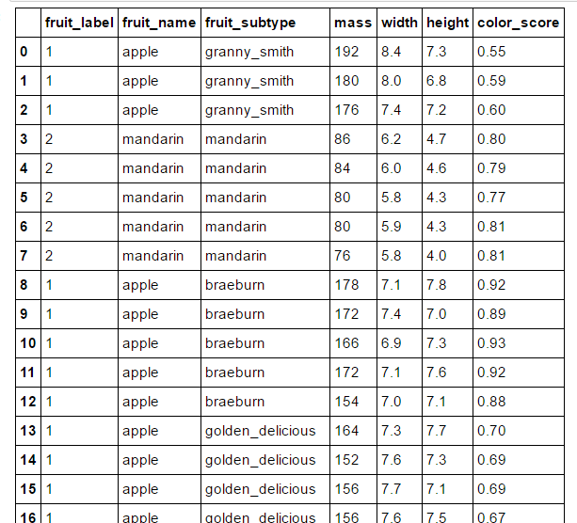

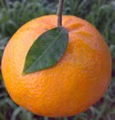
The Fruit Dataset
APPLIED MACHINE LEARNING IN PYTHON
02_Fruits.ipynb
width
lemon
height
apple
orange
mass
color_score
mandarin
fruit_data_with_colors.txt
Credit: Original version of the fruit dataset created by Dr. Iain Murray, Univ. of Edinburgh

Slide 26
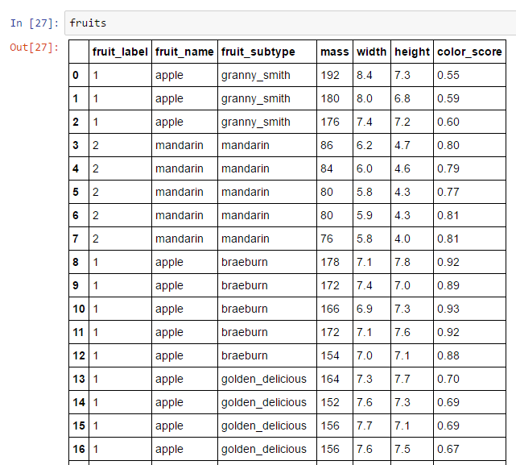
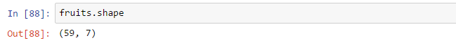
APPLIED MACHINE LEARNING IN PYTHON

Slide 27



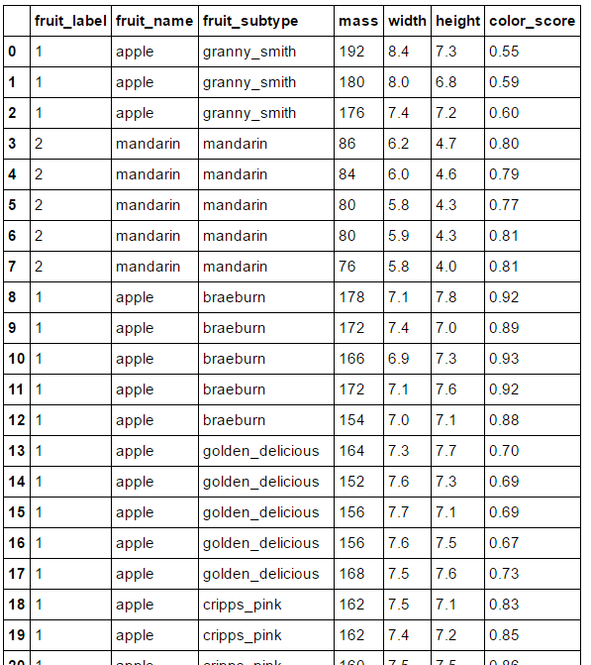





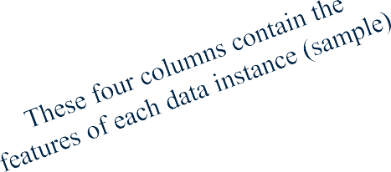


The input data as a table
APPLIED MACHINE LEARNING IN PYTHON
Each row corresponds to a single data instance (sample)
The fruit_label column contains the label for each data instance (sample)

Slide 28
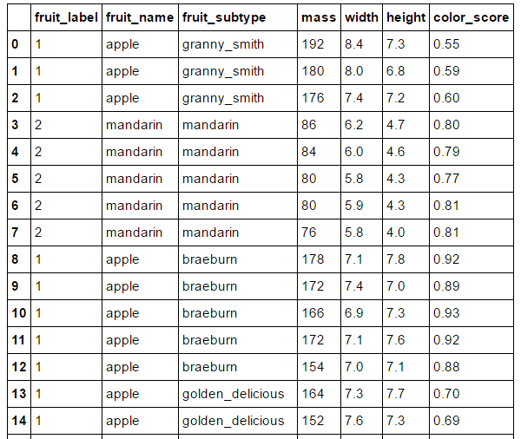
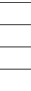
Some reasons why looking at the data initially is important
APPLIED MACHINE LEARNING IN PYTHON
Inspecting feature values may help identify what cleaning or preprocessing still needs to be done once you can see the range or distribution of values that is typical for each attribute.
You might notice missing or noisy data, or inconsistencies such as the wrong data type being used for a column, incorrect units of measurements for a particular column, or that there aren’t enough examples of a particular class.
You may realize that your problem is actually solvable without machine learning.
Examples of incorrect or missing feature values

Slide 29
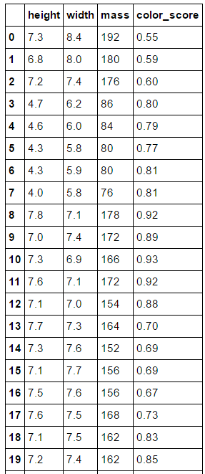
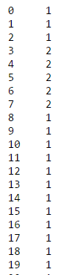
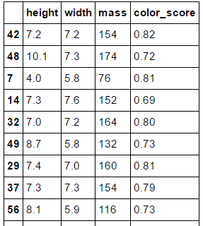
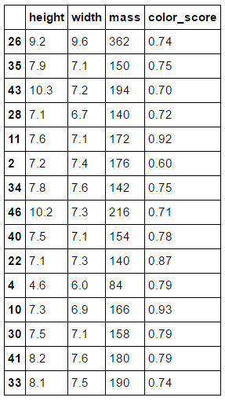
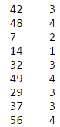
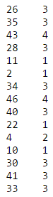


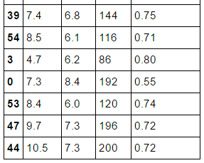
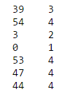


Creating Training and Testing Sets
APPLIED MACHINE LEARNING IN PYTHON
X
y
X_train y_train
X_test y_test
X_train, X_test, y_train, y_test
= train_test_split(X, y)
…
…
…
Original data set
Training set
Test set

Slide 30
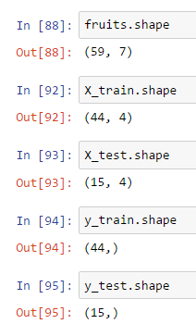
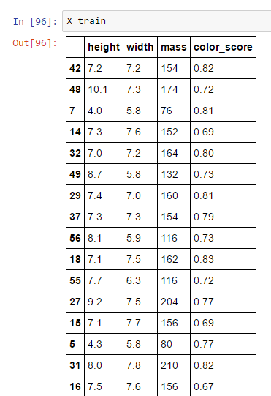
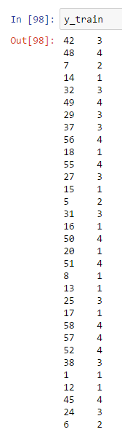
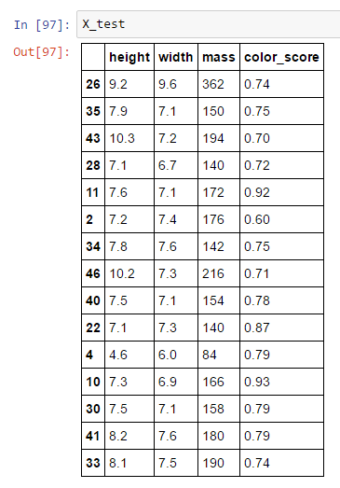
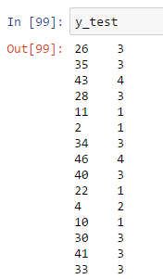
APPLIED MACHINE LEARNING IN PYTHON

Slide 31
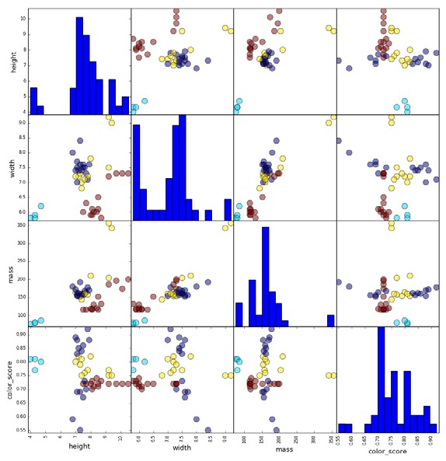
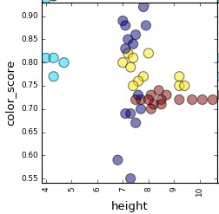
A pairwise feature scatterplot visualizes the data using all possible pairs of features, with one scatterplot per feature pair, and histograms for each feature along the diagonal
APPLIED MACHINE LEARNING IN PYTHON
height
apple
mandarin
orange
lemon
apple
width
mass
color_score
Individual scatterplot plotting all fruits by their height and color_score.
Colors represent different fruit classes.
height
width
mass color_score

Slide 32

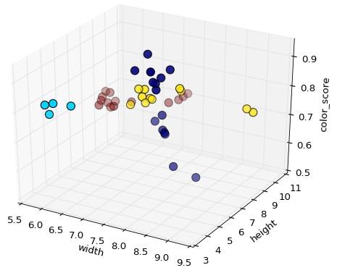
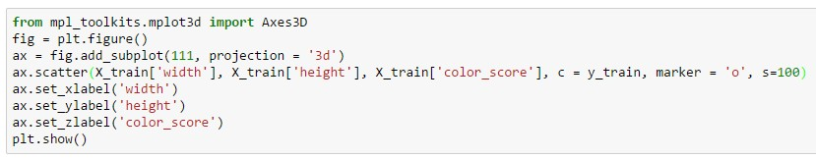
A three-dimensional feature scatterplot
APPLIED MACHINE LEARNING IN PYTHON
apple
mandarin
lemon
orange

Slide 33
The k-Nearest Neighbor (k-NN) Classifier Algorithm
APPLIED MACHINE LEARNING IN PYTHON
Given a training set X_train with labels y_train, and given a new instance x_test to be classified:
Find the most similar instances (let's call them X_NN) to x_test that are in X_train.
Get the labels y_NN for the instances in X_NN
Predict the label for x_test by combining the labels y_NN
e.g. simple majority vote

Slide 34
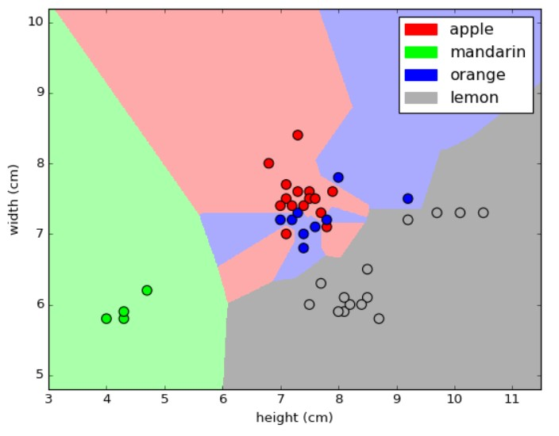
APPLIED MACHINE LEARNING IN PYTHON
A visual explanation of k-NN
classifiers
Fruit dataset Decision boundaries with k = 1

Slide 35
A nearest neighbor algorithm needs four things specified
APPLIED MACHINE LEARNING IN PYTHON
A distance metric
How many 'nearest' neighbors to look at?
Optional weighting function on the neighbor points
Method for aggregating the classes of neighbor points

Slide 36
A nearest neighbor algorithm needs four things specified
APPLIED MACHINE LEARNING IN PYTHON
A distance metric
Typically Euclidean (Minkowski with p = 2)
How many 'nearest' neighbors to look at?
e.g. five
Optional weighting function on the neighbor points
Ignored
How to aggregate the classes of neighbor points Simple majority vote
(Class with the most representatives among nearest neighbors)

Slide 37

APPLIED MACHINE LEARNING IN PYTHON
K-nearest neighbors (k=1) for fruit dataset

Slide 38

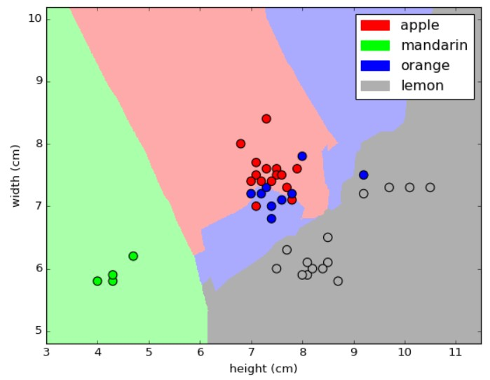
APPLIED MACHINE LEARNING IN PYTHON
K-nearest neighbors (k=5) for fruit dataset

Slide 39

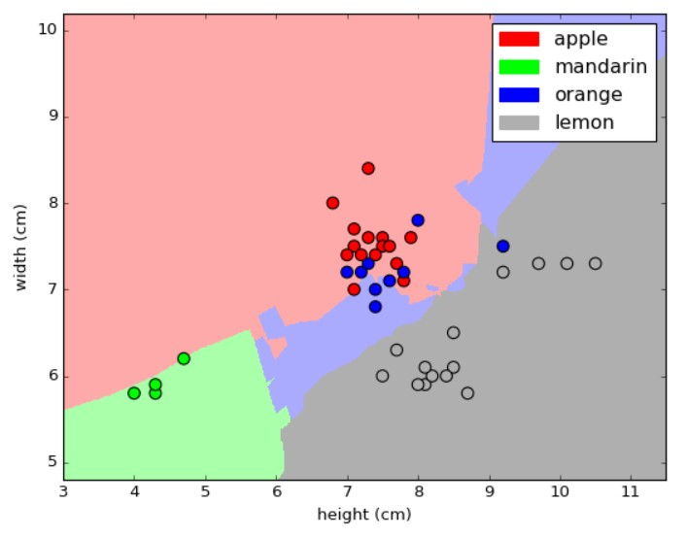
K-nearest neighbors (k=10) for fruit dataset
APPLIED MACHINE LEARNING IN PYTHON

Slide 40
Overfitting

Slide 41
Generalization, Overfitting, and Underfitting
APPLIED MACHINE LEARNING IN PYTHON
Generalization ability refers to an algorithm's ability to give accurate predictions for new, previously unseen data.
Assumptions:
Future unseen data (test set) will have the same properties as the current training sets.
Thus, models that are accurate on the training set are expected to be accurate on the test set.
But that may not happen if the trained model is tuned too specifically to the training set.
Models that are too complex for the amount of training data available are said to overfit and are not likely to generalize well to new examples.
Models that are too simple, that don't even do well on the training data, are said to underfit and also not likely to generalize well.

Slide 42




Overfitting in regression
APPLIED MACHINE LEARNING IN PYTHON
Target variable
Input variable

Slide 43






Overfitting in classification
APPLIED MACHINE LEARNING IN PYTHON
Feature 2
Feature 1

Slide 44
The R² ("r-squared") Regression Score
APPLIED MACHINE LEARNING IN PYTHON
Measures how well a prediction model for regression fits the given data.
The score is between 0 and 1:
A value of 0 corresponds to a constant model that predicts the mean value of all training target values.
A value of 1 corresponds to perfect prediction
Also known as "coefficient of determination"

Slide 45


The relationship between model complexity and training/test performance
APPLIED MACHINE LEARNING IN PYTHON
Training set score
Model accuracy
Test set score
Best model
Model complexity

Slide 46
Regression

Slide 47
Sklearn: Regresión
Las técnicas de regresión nos permiten estimar un valor continuo a partir de una serie de variables predictoras.
En función del algoritmo que utilicemos estaremos construyendo una función lineal o no lineal para minimizar una función de costes sobre el conjunto de datos de entrenamiento (típicamente la función de error acumulado entre nuestras prediciones y los valores.
La mayoría de los algoritmos en sklearn tienen una interfaz similar, vamos a ver un ejemplo con una regresión lineal para estimar el precio de la vivienda con el dataset de boston.

Slide 48
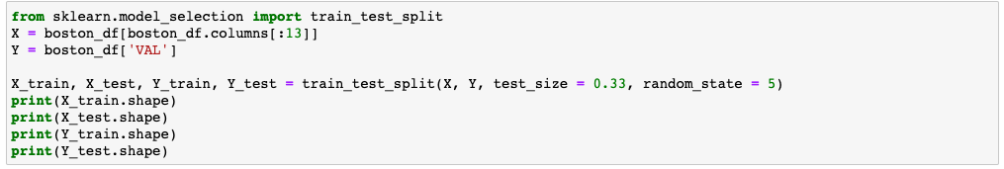
Sklearn: Separar conjuntos de entrenamiento y test
Hasta ahora en los ejemplos hemos estado utilizando todo el mismo dataset para entrenar y para medir sobre él el performance del modelo, en un caso real querremos separar un conjunto de test haremos que no participe en el entrenamiento y evaluaremos el performance sobre este subconjunto.
El módulo model_selection además de utilidades para evaluar el ajuste de distintos estimadores, proporciona una función para separar de un modo rápido y sencillo un dataset en 2 conjuntos, uno para entrenamiento y otro para validación.

Slide 49
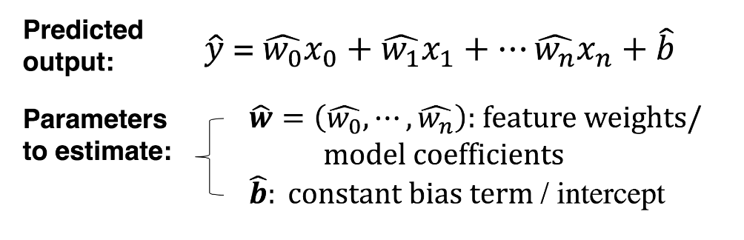
Linear Models
APPLIED MACHINE LEARNING IN PYTHON
A linear model is a sum of weighted variables that predicts a target output value given an input data instance

Slide 50

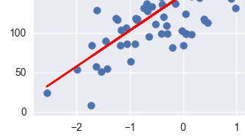
Least-Squares Linear Regression ("Ordinary least-squares")
APPLIED MACHINE LEARNING IN PYTHON
Finds w and b that minimizes the mean squared error of the linear model: the sum of squared differences between predicted target and actual target values.
No parameters to control model complexity.

Slide 51
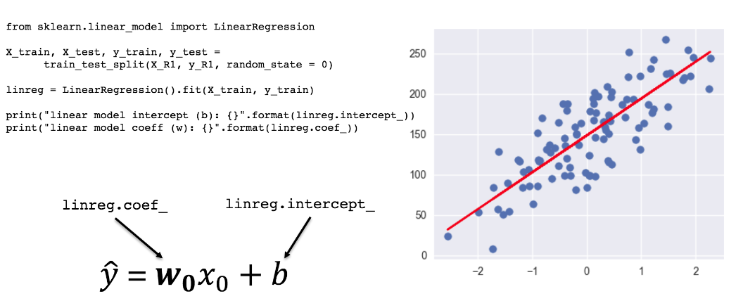
Least-Squares Linear Regression in Scikit-Learn
APPLIED MACHINE LEARNING IN PYTHON
linear model coeff (w): [ 45.70870465]
linear model intercept (b): 148.44575345658873 R-squared score (training): 0.679
R-squared score (test): 0.492

Slide 52
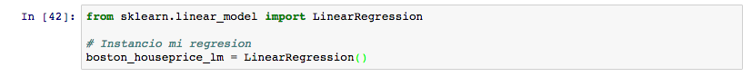
Sklearn: Regresión
Lo primero es instanciar el modelo que queremos utilizar
A continuación ya podemos entrenar nuestro modelo, independientemente del modelo, se utilizará el método modelo.fit(X, y), donde X es el conjunto de variables e y contiene el valor a predecir.

Slide 53
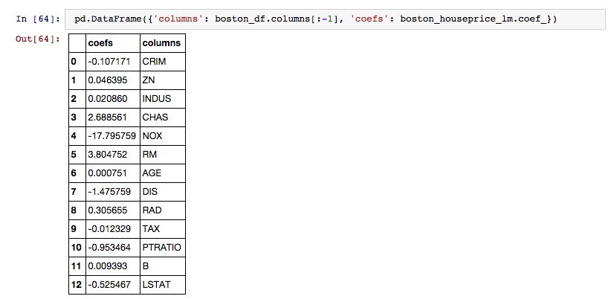
Sklearn: Regresión
Podemos ver los coeficientes resultado del entrenamiento:

Slide 54
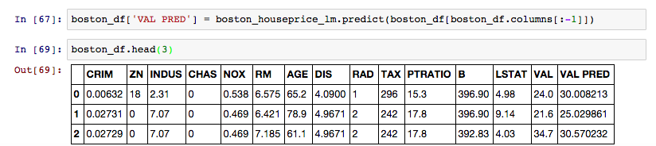
Sklearn: Regresión
Y utilizar el modelo para predecir valores mediante el metodo predict(X)

Slide 55
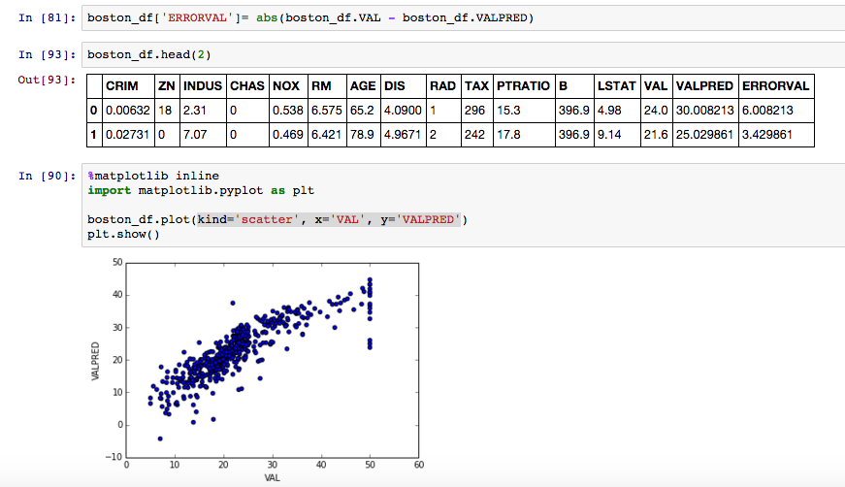
Sklearn: Regresión

Slide 56
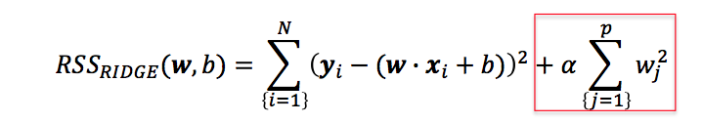
Ridge Regression
APPLIED MACHINE LEARNING IN PYTHON
Ridge regression learns w, b using the same least-squares criterion but adds a penalty for large variations in w parameters
Once the parameters are learned, the ridge regression prediction formula is the same as ordinary least-squares.
The addition of a parameter penalty is called regularization. Regularization prevents overfitting by restricting the model, typically to reduce its complexity.
Ridge regression uses L2 regularization: minimize sum of squares of w entries
The influence of the regularization term is controlled by the 𝛼𝛼 parameter.
Higher alpha means more regularization and simpler models.

Slide 57
Ejercicio
Calcula con el dataset de Boston el error (absoluto) para cada predicción
Calcula el error absoluto máximo, mínimo y el medio
Dibuja un gráfico de dispersión con el valor real en el eje X
y la predicción en el Y (pista: kind='scatter', x=‘COL_X', y=‘COL_Y’)
Dibuja un gráfico de dispersión ERR vs CRIM
Repite el ejercicio con una regresión de tipo Lasso (tb en linearmodels de sklearn)
Utiliza una regresión de tipo Ridge, y comparar los tipos utilizados.

Slide 58
Decision Tree

Slide 59







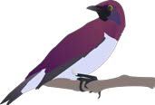
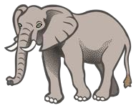

Decision Tree Example
APPLIED MACHINE LEARNING IN PYTHON
Is it alive?
No
Yes
Objects with Alive == No

Slide 60



Decision Tree Example
APPLIED MACHINE LEARNING IN PYTHON
Is it alive?
No
Yes
Does it fly?
No
Yes
Carry > 10 people?
No
Yes
Objects with: Alive == No AND Fly == No
AND Carry > 10 == No

Slide 61
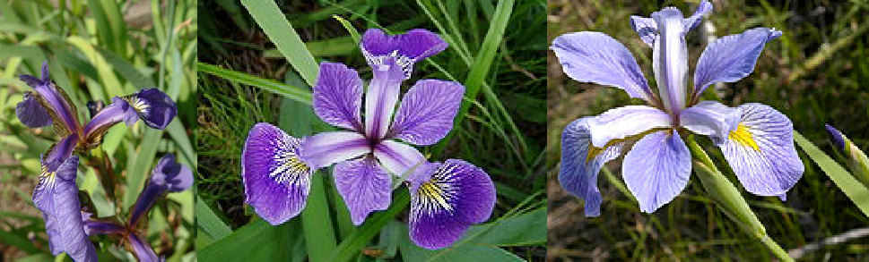


The Iris Dataset
APPLIED MACHINE LEARNING IN PYTHON
petal
150 flowers
3 species
50 examples/species
sepal
Iris setosa
Iris versicolor
Iris virginica
Photo credit: Radomił Binek via https://en.wikipedia.org/wiki/Iris_flower_data_set

Slide 62







Decision Tree Splits
APPLIED MACHINE LEARNING IN PYTHON
Split point
petal width (cm) > 1.2
samples = 75
value = [0, 34, 41] class = virginica
Split point
samples at this leaf have:
petal length <= 2.35
setosa
samples at this leaf have: petal length > 2.35 AND petal width <= 1.2
samples at this leaf have: petal length > 2.35 AND petal width > 1.2
versicolor
virginica

Slide 63
Informativeness of Splits
APPLIED MACHINE LEARNING IN PYTHON
The value list gives the number of samples of each class that end up at this leaf node during training.
The iris dataset has 3 classes, so there are three counts.
This leaf has 37 setosa samples, zero versicolor, and zero virginica samples.
This leaf has 0 setosa, 33 versicolor, and 3 virginica samples.
This leaf has 0 setosa, 1 versicolor, and 38 virginica samples.

Slide 64

Visualizing Decision Trees
APPLIED MACHINE LEARNING IN PYTHON
See: plot_decision_tree() function in adspy_shared_utilities.py code

Slide 65
Decision Trees: Pros and Cons
APPLIED MACHINE LEARNING IN PYTHON
Pros:
Easily visualized and interpreted.
No feature normalization or scaling typically needed.
Work well with datasets using a mixture of feature types (continuous, categorical, binary)
Cons:
Even after tuning, decision trees can often still overfit.
Usually need an ensemble of trees for better generalization performance.

Slide 66
Classification

Slide 67
Sklearn: Clasificación
La clasificación también es un método de aprendizaje supervisado, en clasificación el objetivo es determinar a qué clase o categoría pertenece una observación, nuestra salida es un valor categórico, desde los problemas binarios (0 o 1) hasta los problemas multiclase.
Pandas dispone de distintos clasificadores, desde los más básicos como árboles o sgd classifier hasta los más complejos métodos de boosting.
Vamos a estudiar la clasificación con otros de los datasets de ejemplo, en este caso el iris, se trata de la caracterización de una serie de plantas de 3 especies distintas.
Ejercicio:
Carga el dataset de iris
Crea un DataFrame con los datos del iris, añadiéndole el “target” (0, 1, 2) y el “classname” (setosa, versicolor, virginica)
Crea un conjunto de entrenamiento (X_train, y_train) y un conjunto de test (X_test, y_test) a partir del dataset completo

Slide 68


Sklearn: Clasificación
Para entender el dataset con el que trabajamos, tenemos diferentes opciones.

Slide 69
Sklearn: Clasificación
Pese a tratarse de un problema distinto, el tipo de interfaz que ofrecen en sklearn los clasificadores es similar al de los regresores, en general, lo que estaremos haciendo una vez ya hemos preparado, limpiado y entendido nuestros datos será:
Elegir el algoritmo a emplear
Instanciar un clasificador del tipo deseado
Entrenar el clasificador mediante el método .fit()
Utilizar el clasificador para estimar las clases de los elementos de nuestro conjunto de test mediante predict(). En clasificadores también tenemos un método que nos da la confianza o probabilidad de pertenencia a la clase: predict_proba()
Evaluar el rendimiento del modelo

Slide 70

Sklearn: Clasificación
Utilizaremos un árbol de decisión, del módulo tree:

Slide 71
Sklearn: Clasificación
Utilizaremos un árbol de decisión, del módulo tree:
Ejercicio:
Entrena el árbol con el conjunto train
Utiliza el método predict() para calcular las prediciones sobre el conjunto de test
Calcula el error de clasificacion: errores/total
Crea una matriz de confusión: clase_real, clase_predictor, numero_casos
Repite el ejercicio con otro clasificador de Sklearn, ¿cuál da mejor resultado? http://scikit-learn.org/stable/auto_examples/classification/plot_classifier_comparison.html
Empaqueta la parte de entrenamiento, scoring y calculo del performance como una función

Slide 72


Sklearn: Clasificación
Podemos utilizar directamente el método .score() para tener el rendimiento del modelo con un conjunto de datos etiquetados de test:
En el caso del árbol, podemos exportar las reglas del mismo:

Slide 73
Sklearn: Ejercicio Final
Descarga el dataset titanic.csv. Puedes encontrar una explicación de los campos en https://www.kaggle.com/c/titanic/data
Carga el dataset en un DataFrame, el índice del DataFrame debe ser el nombre del pasajero.
Elimina las columnas ticket number y cabina
Analiza las columnas, en aquellas que aparezcan valores nulos, reemplaza esos valores por la media o la moda (valor más frecuente)
Separa el dataset en train y test.
Entrena al menos los siguientes clasificadores para predecir la variable “survived”: DecisionTreeClassifier, SGDClassifier, RidgeClassifier, KNeighborsClassifier, RandomForestClassifier (*)
Rankea los clasificadores por su performance, medido como % de aciertos. Comparalos contra el modelo naive (i.e. asociar a todas las observaciones el resultado más frecuente)
(*) La mayoría de los clasificadores funcionan solo con variables numéricas, si tenemos una categórica como ‘hombre’-’mujer’, es habitual convertirlo en dos variables tipo: es_hombre (0/1), es_mujer (0/1). Ver pd.get_dummies()

